Slide 1

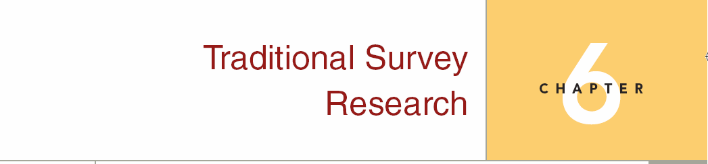
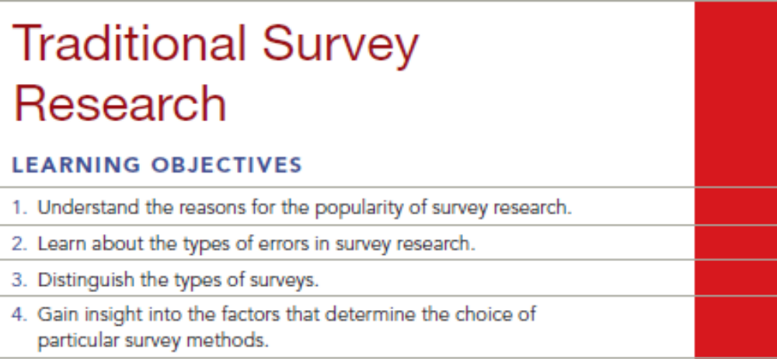
Chapter Six
6-1

Slide 2
Question
The owner of a hardware store in Eureka, California, is interested in determining the demographic characteristics of people who shop at his store versus those of people who shop at competing stores. He also wants to know what his image is relative to the competition. He would like to have the information within three weeks and is working on a limited budget. Which survey method would you recommend? Why?

Slide 3
Answer
A telephone survey is fast and has a relative low cost. This seems to fit the needs of the client. The sample frame used for the survey could be focused on telephone exchanges in the area surrounding Eureka.
Notes:
the sampling frame is the list of population elements or members from which units to be sampled are selected.

Slide 4
Question
Discuss the statement: “A mall intercept interview is representative only of people who shop in that particular mall. Therefore, only surveys that relate to shopping patterns of consumers within that mall should be conducted in a mall intercept interview.”

Slide 5
Answer
If all of the persons shopping at a mall were very similar, this statement would be true.
However, shopping malls are located in urban areas in densely populated regions. One needs only to visit a mall to see that persons from a wide range of demographics shop there.
If the people who shop at the mall are representative of the population of the surrounding area of the city, or even of the nation, then a random sample of the shoppers would be representative of that population. The findings would be able to be generalized.

Slide 6
Question
Discuss the various sources of sample design errors and give examples of each.

Slide 7
Answer
The first type of sampling error is random error. This error occurs because of chance variation in the sample. To reduce the influence of random error, a larger sample should be employed. The larger the sample, other things being equal, the more it represents the population from which it came. For example, perhaps you interviewed fifty people in a population of 50,000 on the merits of building a prison and got results very contrary to what you expected. This could be due to chance, because the sample was so small. Given a larger sample, the results may be more closely aligned with expectations.

Slide 8
Answer (cont’d)
The second type of sampling error is systematic error which includes three types of biases.
  The first is frame error, which results because of using an incomplete or inaccurate sampling frame. An example of this is choosing your respondents from a phone book and missing all those with unlisted numbers, people who have moved, and people with new listings.
  The second type of bias is population specification error. This error is a result of not carefully defining the population of interest from which a sample is drawn. For example, if you were interested in the attitudes of consumers who had purchased a particular brand of tooth paste, yet specified the population as people who shop at a particular grocery store, then your sample may not match your population of interest.
  The third type of bias is selection error which occurs as a result of not choosing a particular respondent for some reason outside of the research project. For example, an interviewer using the mall intercept method typically leaves out the elderly, because he or she doesn’t want to talk to older people.

Slide 9
Question
What types of error might be associated with the following situations?
a. Conducting a survey about attitudes toward city government using the telephone directory as a sample frame.
b. Interviewing respondents only between 8:00 a.m. and 5:00 p.m. on features they would like to see in a new condominium development.
c. Asking people if they have visited the public library in the past two months.
d. Asking people how many tubes of toothpaste they used in the past year.
e. Telling interviewers they can probe using any particular example they wish to make up.

Slide 10
Answer
Sample frame error.
Sample selection error.
Response bias.
Response bias.
Interviewer error.

Slide 11
Question
When survey respondents deliberately falsify their income this is known as which type of bias?
interviewer bias
nonresponse bias
measurement instrument bias
response bias
selection bias

Slide 12
Answer
Ans: D

Slide 13
Question
Which of the following is currently the least popular type of data collection?
Internet surveys
mall-intercept interviews
door-to-door interviews
telephone surveys

Slide 14
Answer
Ans: C

Slide 15
Question
The Bureau of the Census reported that a more accurate estimate of the total population in the U.S. could be accomplished by a carefully selected sample, rather than with a census. What broad classification of errors is the researcher indirectly alluding to?
random error
selection error
measurement error
frame error
none of these

Slide 16
Answer
Ans: C

Slide 17
Question
Why is it important to consider measurement error in survey research?

Slide 18
Answer
Ans: Measurement error occurs when there is a variation between the information being sought and the information obtained by the measurement process. Measurement error is very important in survey research because if the questions being asked, or the way in which they are being asked, are not consistent and accurate, then the data received are of far less value.

